Slide 1
Universal Credit:
28/04/2018 Robert Thompson
Southwark

Slide 2
How can carers access the Carers Advice Service?
Email or printed information to assist with self-help
A face-to-face (or telephone) appointment with an adviser
Referral received
We aim to call the carer to discuss their issue within 1 working day
Signpost or referral to relevant organisation
Referral number: 0207 358 8711 Referrals can be made via www.citizensadvicesouthwark.org.uk

Slide 3
How can carers access the Carers Advice Service?
Email or printed information to assist with self-help
Call us or leave a voicemail
A face-to-face (or telephone) appointment with an adviser
Drop us an email
Attend drop-in sessions at Peckham or Bermondsey offices
Signpost or referral to relevant organisation
Carer’s Local Line: 0207 358 8711 Contact us by email form available at www.citizensadvicesouthwark.org.uk

Slide 4
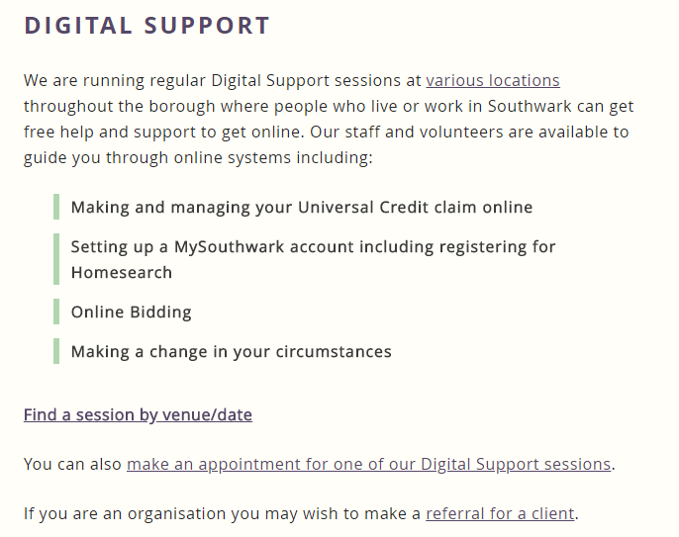
Digital Support Drop-in
Drop-in sessions across multiple locations including:
The Green, Nunhead
Blue Anchor Library
Leathermarket JMB
Neckinger TRA
Lewington Centre
www.citizensadvicesouthwark.org.uk for the full calendar.

Slide 5
What we’re going to cover
What Universal Credit is and who can claim;
How much you can get;
The things you may be expected to do;
If you or someone you look after is unwell;
If something goes wrong.

Slide 6
What is Universal Credit?
One monthly payment that replaces 6 old “legacy” benefits. It only applies to working age people.
BENEFITS THAT GO | BENEFITS THAT STAY
Income based JSA; income based Employment and Support Allowance; Income Support; Working Tax Credits; Child Tax Credits; Housing Benefit. | PIP, DLA, Attendance Allowance; Child Benefit Council Tax Reduction; Carer’s Allowance; Benefits for people who are Pension Credit Age Contribution-based ESA and JSA And many more…

Slide 7
The good and the bad…
THE GOOD | THE BAD
Your income is usually automatically given to the DWP so you don't have to keep updating them A lot of your earnings can be ignored so you can be better off There’s less benefit claims to deal with at once It’s online – if you’re good at computers It gives you a breakdown and a history of everything online You don’t always need to call the DWP if there’s a problem | It can be complicated to understand how it all works It can be difficult if you’re not good with computers The amount you get might be less than under the old system You may have to wait longer between payments

Slide 8
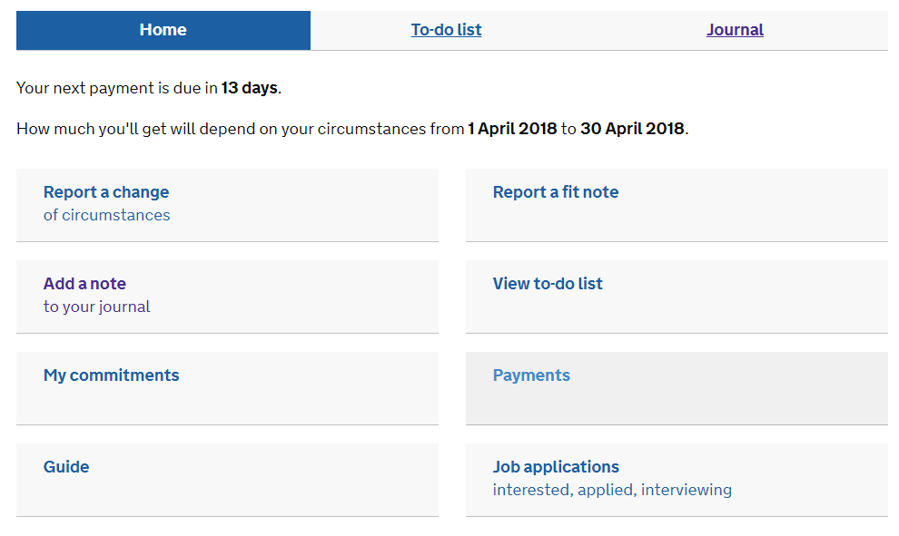
This is what your Home screen looks like

Slide 9
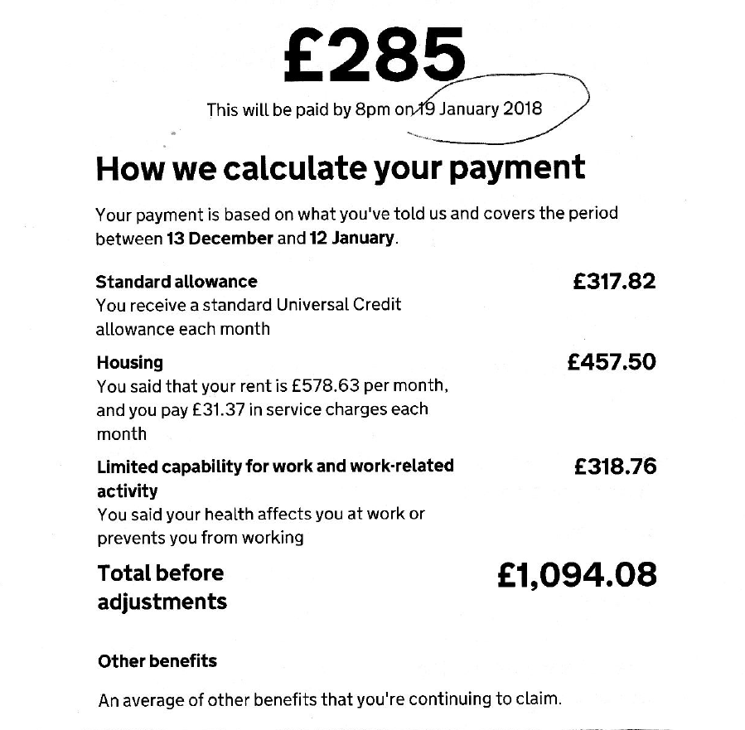
Example payment breakdown. You get one for each payment.

Slide 10
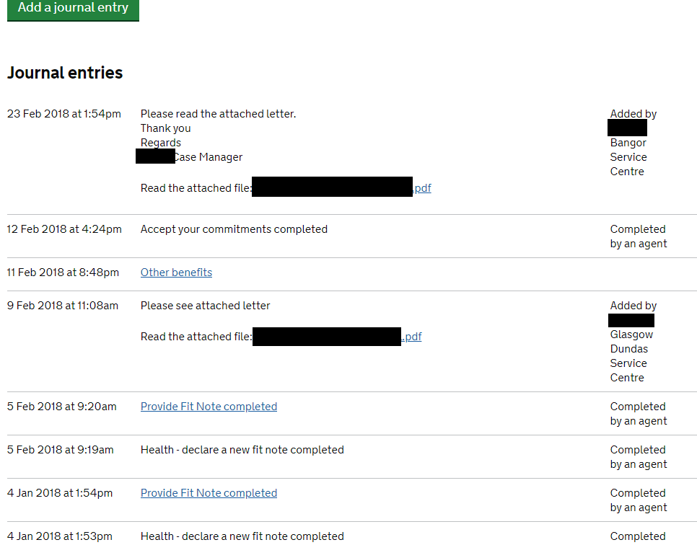
Example journal history

Slide 11
When to apply?
If you are already getting all of the legacy benefits you’re entitled to then you don’t need to do anything. You will be moved onto UC in the coming years, and get ‘transitional protection’ so you don’t lose out if you’d get less.
If there is a change of circumstance that means you need to apply for any of the replaced benefits, then you will need to make a new claim for Universal Credit instead if you are eligible to claim.
E.g. You’re on JSA and become sick so want to apply for ESA, you’d have to claim UC instead.

Slide 12
Who can apply? Not everyone!
There are some cases in which you cannot claim Universal Credit. If these apply to you, you need to apply for legacy benefits instead.
If you’re in supported accommodation;
If you live somewhere UC isn’t introduced;
If you are responsible for more than two children;
And many more…
Consider getting advice if you’re not sure.

Slide 13
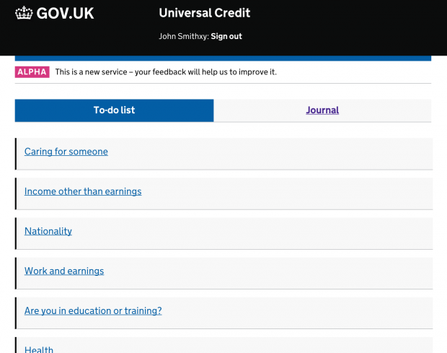
How to apply
You apply online. No need to make a call.
Most communication is done through your online journal;
Tasks you have to do appear in your to-do list (see picture);
You have to accept a tailored ‘claimant commitment’, e.g. ‘I will look for work for 16 hours per week;’
Earnings are calculated each month using HMRC data so most people don’t have to keep updating information.

Slide 14
How much UC can you get?
Unfortunately no easy answer – use a benefits calculator on the web
Examples are included for you
Working out UC is a five-step process:
Check the amount of savings they have;
Add up the total they could get (based on circumstances);
If they’re working check if any of their income is ignored;
Deduct any earnings that aren’t ignored;
Apply the benefit cap.

Slide 15
Example: Jane
Let’s walk through the process with Jane.
Jane’s circumstances:
Jane is 55 years-old.
Jane has no savings. Jane is single. Jane has a one daughter who is 14.
Jane gets DLA – Middle Rate Care – for her daughter.
Jane is a council tenant with £100 per week rent.
Jane works part-time and earns £200 per month.
Jane has a personal pension of £50 per month.

Slide 16
Step 1: Savings
First we check Jane’s savings. We know that Jane has no savings so this is okay.
If Jane had more than £16,000 in savings Jane would not be able to claim Universal Credit.
If Jane had more between £6,000 and £16,000 in savings they would be taken away at the end.
1. Savings
2. Maximum amount
3 Check ignored earnings
4. Deduct any income
5. Benefit Cap

Slide 17
Step 2: Maximum amount
Total: £1310.46
£156.45 Carer Element
We check all the different bits of Universal Credit that Jane can get. They’re like lego blocks with each block being worth an amount of money. All of the blocks added together is the maximum Universal Credit that Jane could get before considering any deductions.
There’s blocks for: each person to live on (a standard allowance), for having a child (a child element), for having a child on DLA (a disabled child element), for having housing cost (a housing element) ad for being a carer (a carer element).
£433 Housing Element
£126.11 Disabled Child Element
£277.08 Child Element
£317.82 Standard Allowance
4. Deduct any income
3 Check ignored earnings
5. Benefit Cap
2. Maximum amount
1. Savings

Slide 18
Step 3: Check for ignored earnings
Now that we know the total UC Jane can get is £1310 we need to take away any earnings. Before we do this we check if any of Jane’s earnings are ignored.
If the right circumstances are met the DWP will either ignore £192 of Jane’s earnings or £397, depending on her circumstances.
In this case £192 of Jane’s earnings are ignored because Jane has housing costs and responsibility for a child.
4. Deduct any income
3 Check ignored earnings
5. Benefit Cap
2. Maximum amount
1. Savings

Slide 19
Step 4: Deduct any income
We know that Jane’s maximum UC is £1310.46. We know that Jane’s income is £400 per month.
We ignore the first £192 of Jane’s earnings and so we consider Jane to have £208 of earnings that aren’t ignored. For every £1 of earnings Jane has that aren’t ignored, 63p will be taken from Jane’s Universal Credit.
This means £131.04 is taken away from Jane’s UC. This means her total amount is £1179.42.
We then deduct any unearned income. This includes her Pension of £50p/m. This means £50 is taken away, meaning the total is now £1129.42
4. Deduct any income
3 Check ignored earnings
5. Benefit Cap
2. Maximum amount
1. Savings

Slide 20
Step 5: Apply benefit cap (and other deductions)
We would then check if the benefit cap applied – the benefit cap for Jane is £1916.67 per month. This is the maximum benefits Jane can get before the cap applies.
Jane’s total UC is less than this so no deduction applies.
4. Deduct any income
3 Check ignored earnings
5. Benefit Cap
2. Maximum amount
1. Savings

Slide 21
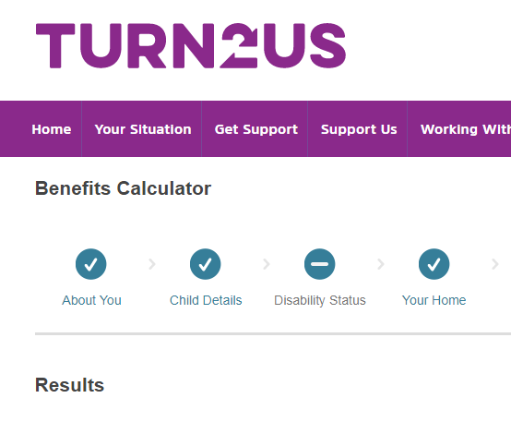
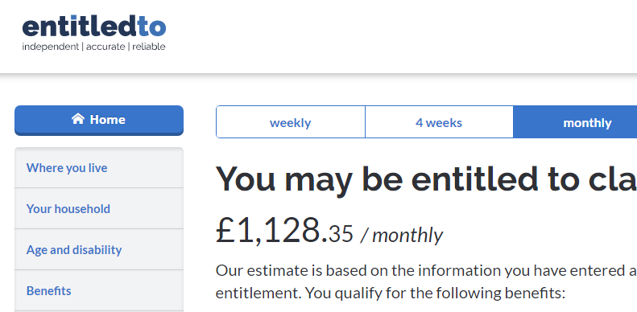
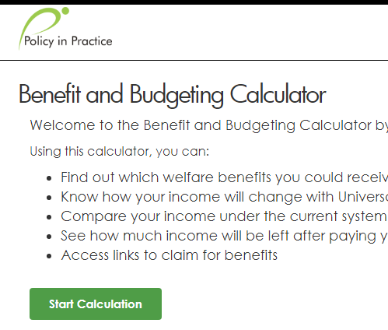
A better way! Use a benefits calculator.
(or your local advice agency)

Slide 22
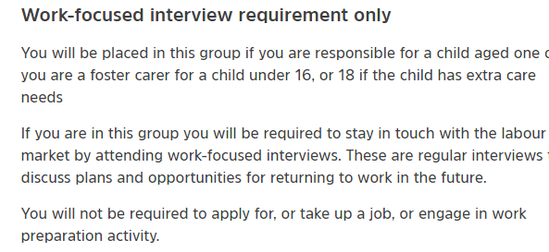
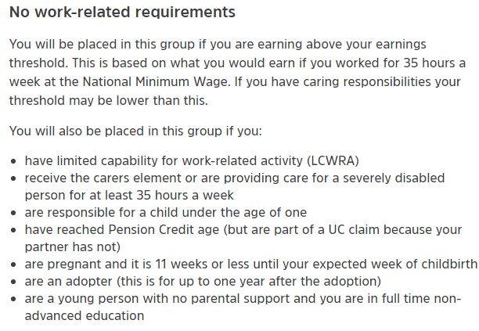
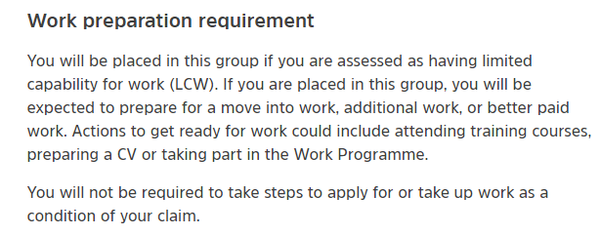
Things you might have to do – your commitments

Slide 23
If you are long-term sick
If you’re unwell for a long time you should provide the DWP ‘fit notes’ from your GP.
After 3 months of providing fit notes you’ll be sent a form asking how your condition affects you.
Once you’ve returned this form you’ll need to attend a face to face assessment.
The result determine whether you get Limited Capability for Work or Limited Capability for Work-Related Activity
For new claims you need to be classed as Limited Capability for Work Related Activity get any extra amount included in your Universal Credit

Slide 24
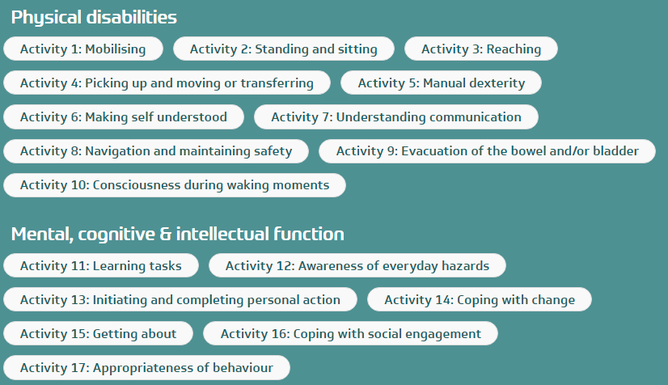
If you are long-term sick
The form and assessment look at lots of different aspects of your life. These aspects are below and are called activities.

Slide 25
If you are long-term sick
If you have a fluctuating condition like sickle cell then you might not always meet the criteria for being classed as long term sick.
The law say that the different activities must “apply to the claimant for the majority of the time or, as the case may be, on the majority of the occasions on which the claimant undertakes or attempts to undertake the activity described by that descriptor.”

Slide 26
If you are a carer
If you care for someone who gets certain benefits you can get a carer element. This is £156 per month and is one the blocks that makes up the maximum Universal Credit that you can get.
The person you care for needs to get Attendance Allowance, Personal Independence Payment with the Daily Living Component, or Disability Living Allowance with at least the middle-rate care component.
You need to be caring at least 35 hours per week.
This is the same criteria as carer’s allowance except it doesn’t matter if you earn more than £120 per week.
If you’re claiming Universal Credit it doesn’t usually make a difference if you claim Carer’s Allowance as all of this is deducted from your Universal Credit

Slide 27
If something goes wrong
Challenge decision by writing on your journal.
If your challenge is turned down you can go to an independent tribunal by filling in form SSCS1.
Step 1 – Get Decision
Will give you a detailed breakdown of the reasons
Step 2 - Challenge on journal
Should be done within one month;
Response they will send is called a ‘Mandatory Reconsideration Notice
Step 3 - Challenge to tribunal
Get help if you cannot understand it
Use form SSCS1 which you can get from the internet. Send within a month.
Send a copy of the notice with your appeal form
Better to pick a face to face hearing
Notes:
Can progress to UT if FTT not successful, but requires specialist support.

Slide 28
Comments and questions

